Slide 1
BRAIN TUMOR SEGMENTATION USING DEEP LEARNING TECHNIQUES
-USING EFFICIENTNET MODEL
Presented by
B. Amara Lingeswara Rao
P. Mani Supriya
Date:28-06-2024

Slide 2
WHAT IS BRAIN TUMOR?
A brain tumor is a cancerous or non-cancerous growth of abnormal cells in the brain. A brain tumor can be benign or malignant. The benign brain tumor has a uniformity in structure and does not contain active (cancer) cells, whereas malignant brain tumors have a non-uniformity in structure and contain active cells.
Key Points:
Purpose: The purpose of brain tumor segmentation is to accurately identify and delineate tumor boundaries within the brain, aiding in precise diagnosis, treatment planning, and monitoring of therapeutic response. This enhances surgical precision, optimizes radiation therapy, and improves overall patient care.
Procedure: The procedure for brain tumor segmentation involves acquiring MRI scans, preprocessing the images, and applying the advanced neural network model EfficientNet to segment the tumor regions The segmented results are then analyzed to assist in clinical decision-making and treatment planning.

Slide 3
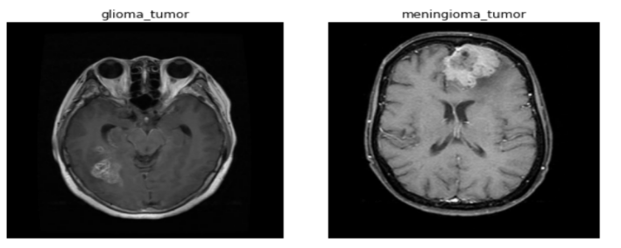
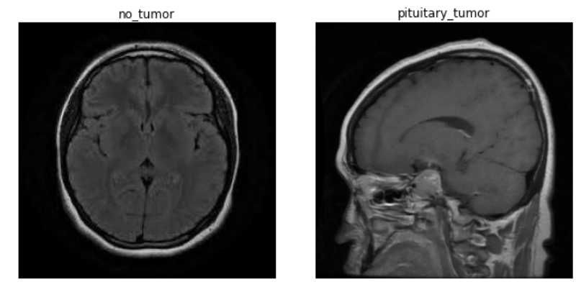
.
Types of Brain Tumor:
Brain tumors can be classified into two main types:
1. Primary Brain Tumors: These originate in the brain and include types such as gliomas, meningiomas, schwannomas, pituitary adenomas, and medulloblastomas.
2. Secondary (Metastatic) Brain Tumors: These originate from cancer cells that have spread to the brain from other parts of the body, such as the lungs, breast, kidney, or skin.
Figure:1

Slide 4
introduction to Efficientnet
In 2019, Tan and Le unveiled EfficientNet, a state-of-the-art CNN architecture. It balances the model's depth, breadth, and height using a unique compound scaling technique. resolution, outperforming other CNN architectures in terms of accuracy while using fewer parameters and computational power.
The depth, width, and resolution of the model are all equally scaled according to a set of principles using the compound scaling approach.
Initially, the authors scale the CNN's depth, resolution, and number of filters using a set of predetermined scaling coefficients.

Slide 5
Advantages of EfficientNet Connectivity:
EfficientNet, a family of convolutional neural networks, offers several advantages:
1. Model Efficiency: EfficientNet achieves superior accuracy with fewer parameters and less computational cost by scaling the network dimensions—depth, width, and resolution—efficiently.
2. Versatility: EfficientNet's architecture is highly versatile and can be scaled up or down to meet various resource constraints, making it suitable for deployment on both high-performance servers and edge devices with limited computing power.

Slide 6
Applications:
EfficientNet's applications span various domains due to its versatility and efficiency:
1. Medical Imaging: Used for detecting and segmenting anomalies in medical images, such as brain tumors, skin lesions, and retinal diseases.
2. Autonomous Vehicles: Enhances object detection, scene understanding, and navigation tasks in self-driving cars.
3. Facial Recognition: Improves accuracy and speed in facial recognition systems for security and authentication purposes.
4. Natural Language Processing: Supports vision-based tasks in multimodal models that combine image and text processing.
5. Retail and E-commerce: Powers visual search, product recommendation, and inventory management systems through accurate image recognition and classification.

Slide 7
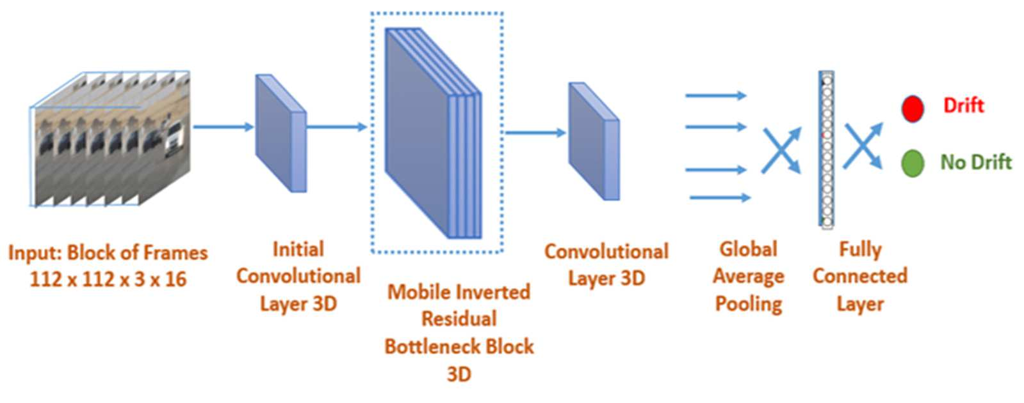
Efficientnet architecture
Figure:3

Slide 8
Efficient net architecture:-
EfficientNet is a convolutional neural network (CNN) architecture designed to achieve high accuracy with fewer computational resources compared to previous architectures. It achieves this through a novel method of scaling the network called compound scaling.
Here are the key components of EfficientNet’s architecture:
Compound scaling: This method scales EfficientNet uniformly across three dimensions: depth, width, and resolution. Depth scaling refers to adding more convolutional layers to the network. Width scaling involves increasing the number of channels in each convolutional layer. Resolution scaling refers to increasing the input image size. By scaling these dimensions together, EfficientNet can achieve significant accuracy gains without requiring a corresponding increase in computational resources.
Mobile Inverted Bottleneck Convolution (MBConv) blocks: These are the building blocks of the EfficientNet architecture. They are a combination of depth-wise separable convolutions and inverted residual blocks. Depth-wise separable convolutions help to reduce computational complexity without sacrificing accuracy. Inverted residual blocks are a type of residual block that can improve the accuracy of the network.
Squeeze-and-Excitation (SE) optimization: This optimization technique is used to improve the performance of the network by recalibrating the feature channels of the convolutional layers.

Slide 9
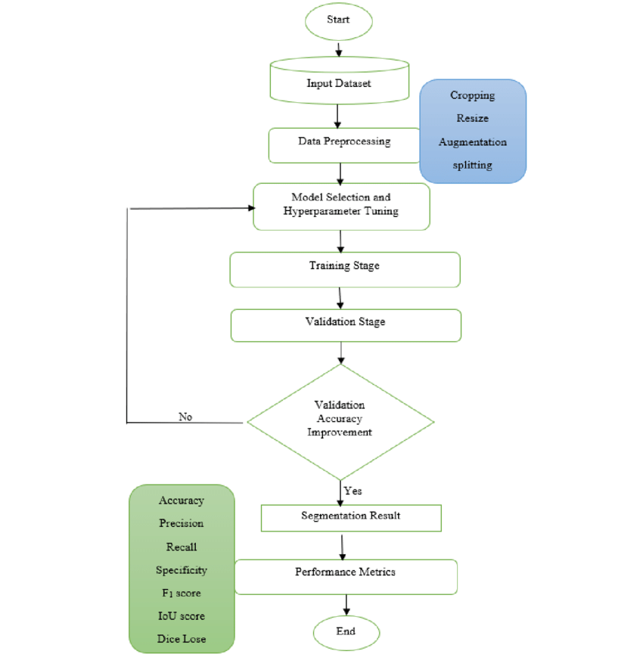
PROPOSED METHODOLOGY :
Using a brain MRI dataset that includes both tumor and non-tumor pictures, the methodology entails gathering the images and per-processing them to improve quality, reduce noise, and equalize intensity levels. A pretrained EfficientNet model is refined using transfer learning on the MRI dataset, and data augmentation techniques are employed during model training to minimize overfitting[6–8]. Accuracy, sensitivity, and specificity of the model are assessed using k-fold cross-validation on a different validation dataset. The model's advantages and disadvantages are then determined by analyzing the data, and recommendations for enhancing its functionality are made. Generally speaking, the method uses transfer learning and trained models to reliably detect and classify brain tumors, which can help doctors plan early diagnosis and treatment.
Figure:4

Slide 10
DATASET
The dataset that we used was the various brain tumor databases. MRI images are among the datasets we obtained from Kaggle. The Dataset contains the MRI pictures of brain tumors.
The Brain Tumor subfolders of Glioma tumor, Meningioma tumor, No tumor, and Pituitary Tumor. The total number of photos for segmentation is 7023 photos make up the Dataset, 4571 photos make up the training dataset, 1141 photos make up the valid dataset, and 1311 photos make up the Test Dataset for belonging to 4 classes(Glioma, Meningioma, No tumor, pituitary tumors).
Category | Training Set | Validation Set | Testing Set
Glioma Tumor | 1321 | 350 | 300
Meningioma Tumor | 1339 | 330 | 306
No Tumor | 1595 | 250 | 405
Pituitary Tumor | 1457 | 211 | 300
Table:1

Slide 11
Preprocessing Data:
Data collection: Build up a large dataset of microscopic images that have been categorized as benign or malignant. The dataset needs to be diverse in order to include a variety of skin types and lesion traits.
Preparing data: Perform picture preparation procedures, such as scaling images to a standard size (224x224 pixels), normalization, and augmentation techniques (e.g., rotation, flipping, zooming), to increase the robustness and generalizability of the model.
Model Selection:
Integration of Base Model: Without the top (completely linked) layer, integrate the
EfficientNet B0 model.
Custom Layers: Overlay the following custom layers over the basic model.
Normalize the activations in the batch normalization layer to enhance generalization and
convergence.
Dense Layer: To avoid overfitting, add a dense layer with 256 neurons, ReLU activation, and regularizers (L2 kernel regularizer, L1 activity regularizer, and bias regularizers).
Dropout Layer: To lessen overfitting, include a dropout layer with a 70% dropout rate.
Output Layer: For binary classification (benign versus malignant), use a dense output layer
with two neurons and softmax activation

Slide 12
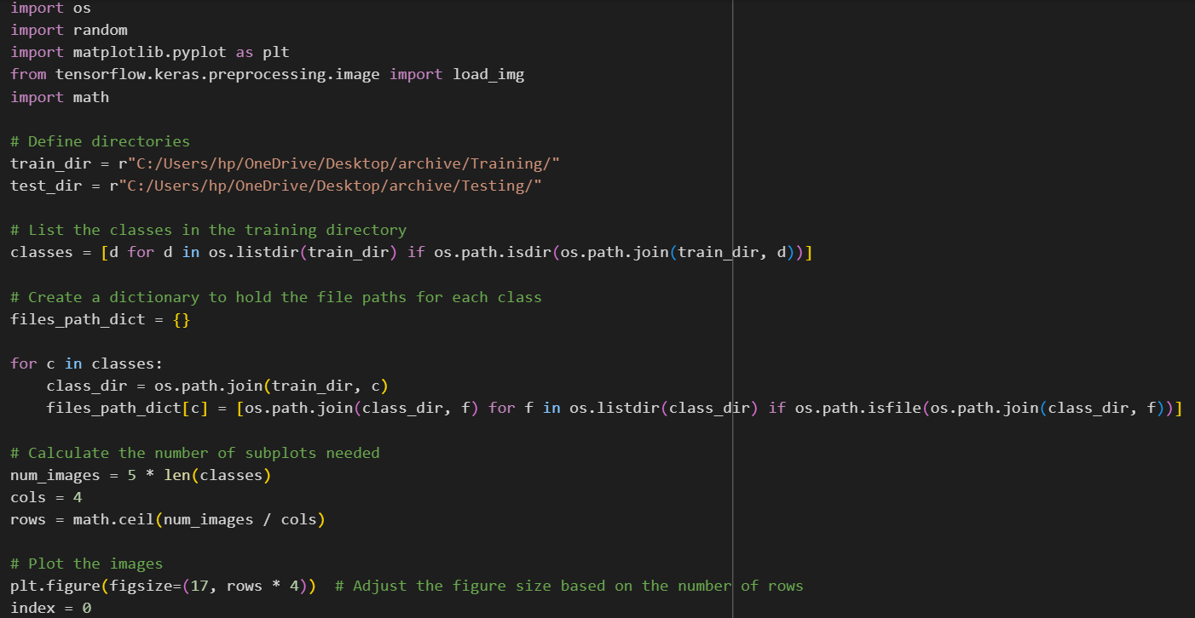
Results:
Preprocessing code:

Slide 13
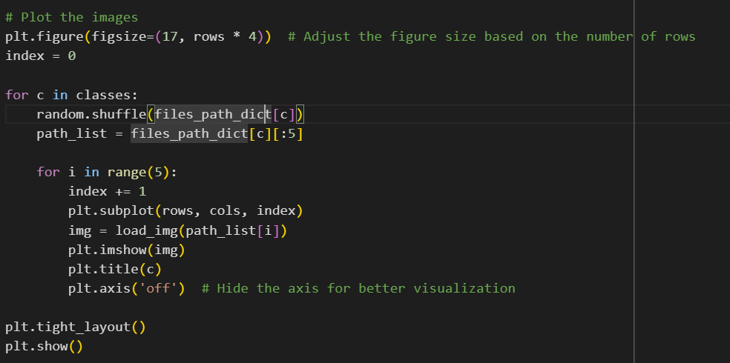

Slide 14
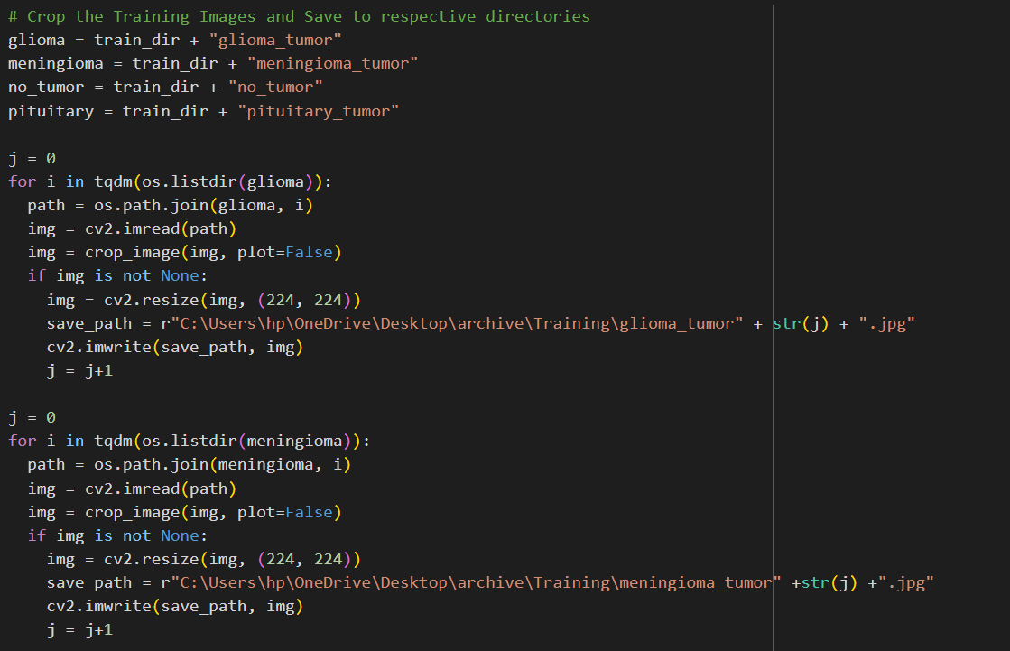
Training the dataset

Slide 15
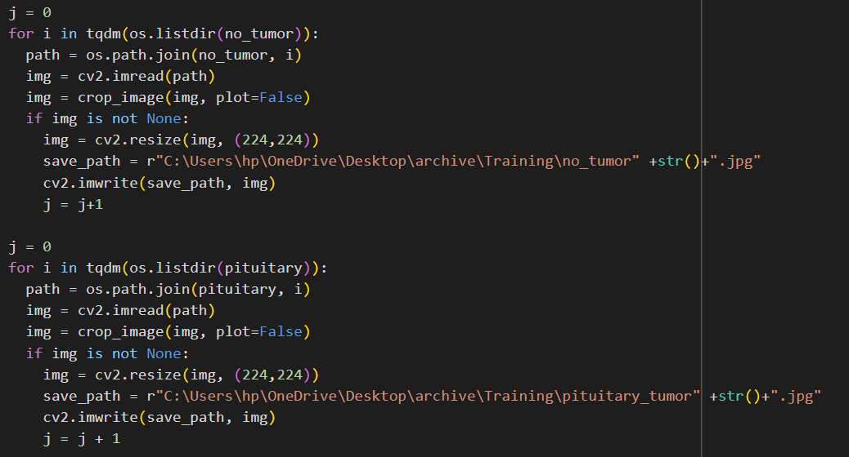

Slide 16
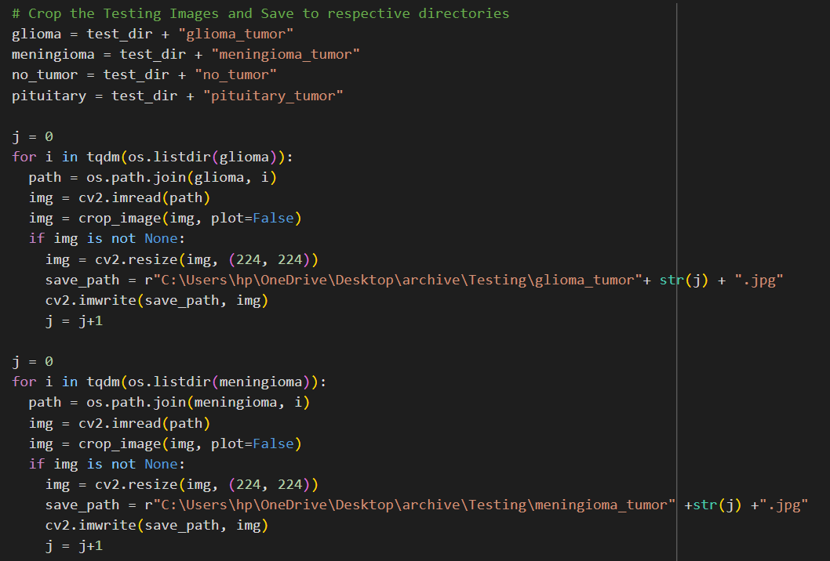
Testing Dataset

Slide 17
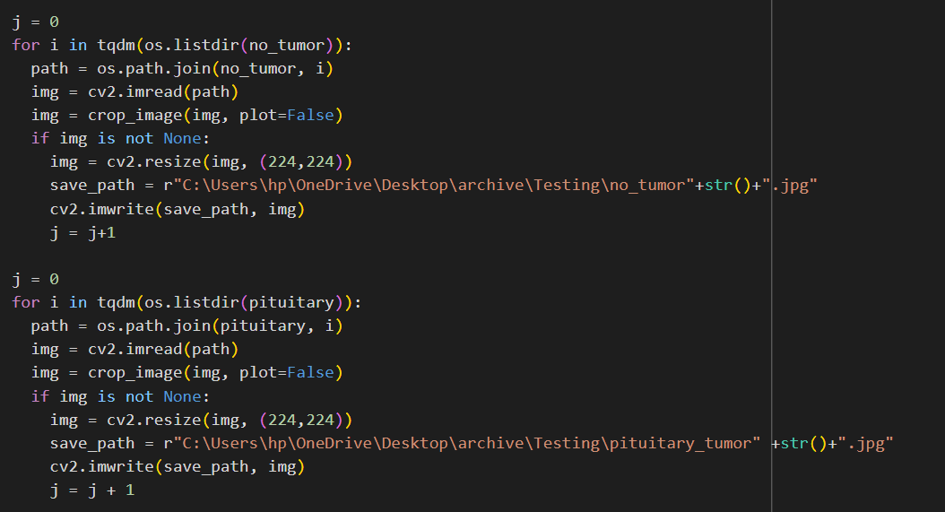

Slide 18
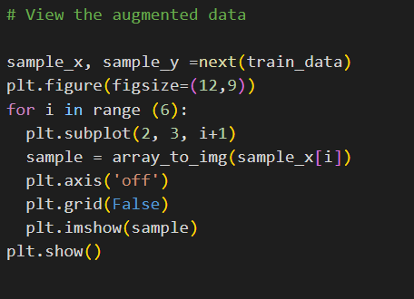
Augmented Data:

Slide 19
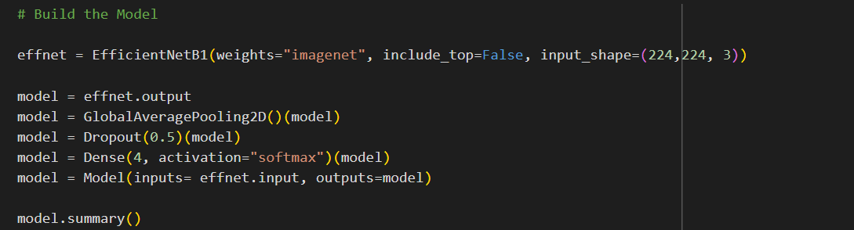
Build the Model:

Slide 20
Model Results
We also worked on existing models to get more knowledge and to understand models clearly. After implementing those models we got these results.
MODEL | TRAINING ACCURACY | TESTING ACCURACY | ACCURACY
CNN | 82.2% | 87% | 83%
RESNET50 | 86% | 80% | 85%
VGG 16 | 87% | 85% | 99%
EFFIECIENTNET B0 | 99% | 87% | 98%
Table:-2
Table:2
The suggested work is carried out with a Google colab and Python. First, we used the CNN model to train this dataset. But the outcome was not better. Later, we extended the number of epochs to 7 and made modifications to a few layers to improve the findings. In order to reflect better outcomes, we are concerned with the loss function, optimizer, epochs, batch size, and layers. The performance of the proposed network was tested and evaluated five times for each experiment. Parameters and hyper parameters were changed throughout training.

Slide 21
Confusion Matrix:
Using the CNN model, we obtained the confusion matrix that is shown below. Every model was assessed using the test dataset after the training phase was over. To validate their performance, F1, area under the curve, accuracy, recall, and precision were utilized. The following is a description of every performance statistic used in this article.
Accuracy: It indicates the degree to which the measured value resembles a known value.
Accuracy = (TP + FN)/ (TP + TF + FP + FN) (2)
Precision: This indicates the model's level of accuracy with respect to positively anticipated data.
Precision = TP / (TP + FP) (3)
Recall: After classifying something as positive, it determines how many real positives the model caught (true positives).
Recall = TP / (TP + FN) (4)
F1: It provides a recall and accurate balancing.

Slide 22
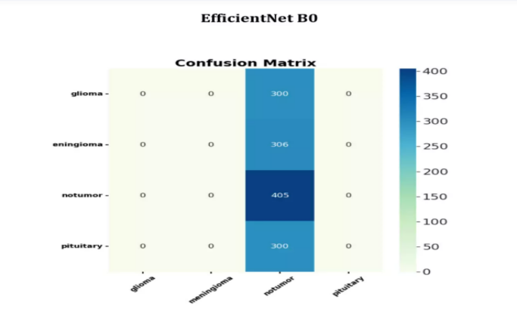
Confusion matrix
Using the CNN model, we obtained the confusion matrix that is shown below. Every model was assessed using the test dataset after the training phase was over. To validate their performance, F1, area under the curve, accuracy, recall, and precision were utilized. The following is a description of every performance statistic used in this article.
Accuracy: It indicates the degree to which the measured value resembles a known value.
Accuracy = (TP + FN)/ (TP + TF + FP + FN) (2)
Precision: This indicates the model's level of accuracy with respect to positively anticipated data.
Precision = TP / (TP + FP) (3)
Figure 5 : Confusion Matrix

Slide 23
EFFICIENTNET ACCURACY:
An objective function called Eff-Net loss is used during the training process of an EffNet model, which is often a deep learning architecture for image segmentation. In order to improve segmentation accuracy and handle class imbalances, the loss function typically adds variables like dice coefficient or intersection over union (IoU) to pixel-wise loss, such as binary cross-entropy or categorical cross-entropy.
EFFICIENTNET LOSS:
Eff-Net loss is the objective function that is used to train an Eff-Net model, which is often a deep learning architecture for image segmentation. The loss function usually adds variables to pixel-wise loss, like binary cross-entropy or categorical cross-entropy, to address class imbalances and increase segmentation accuracy, such as dice coefficient or intersection over union (IoU).

Slide 24
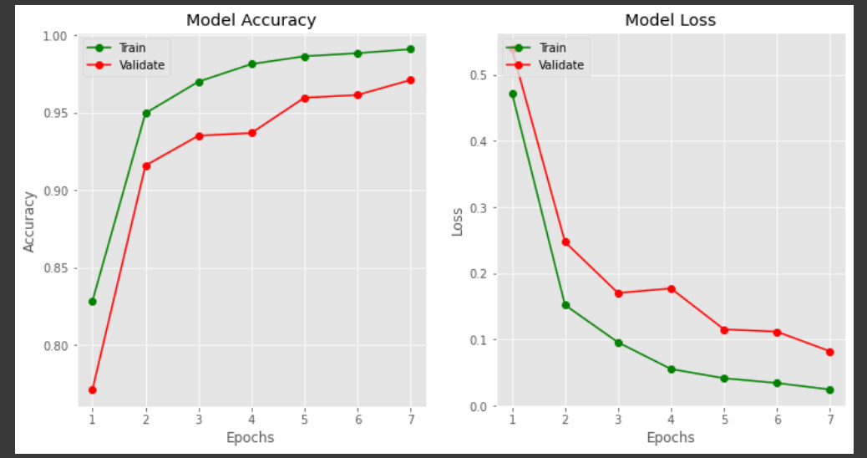
Figure6: Graph on Training & Validation Loss, Accuracy

Slide 25
DISCUSSION:
The majority of research in brain tumor segmentation has focused on binary classification tasks, where the primary goal is to determine the presence or absence of a tumor in MRI scans. Advanced CNN architectures, such as U-Net, and the more recent EfficientNet, have shown promising results in enhancing segmentation accuracy. These models leverage extensive datasets and sophisticated data augmentation techniques to improve generalization and robustness. The use of specialized loss functions like Dice loss and Intersection over Union (IoU) further refine the model's performance, ensuring better overlap between predicted and ground truth masks.
CONCLUSION :
In this work, we proposed a method for brain tumor identification and categorization based on the latest deep learning architecture, EfficientNet. On the test set, our suggested model's accuracy of 97.2% is a promising outcome for the diagnosis and categorization of brain tumors. EfficientNet transfer learning combined with small-scale dataset fine-tuning worked well for this task. The pretrained weights allowed the model to pick up significant traits, and it generalized well to the new data. It is also shown how crucial data preprocessing and augmentation methods are to raising the model's efficiency. Preprocessing methods like normalization and scaling, together with augmentation methods like flipping and rotation, helped to broaden the dataset's variety and lessen overfitting.

